Slide 1


Welcome to
SHOPEE-IET
Machine Learning
Challenge
Opening Ceremony
11th, March 2018

Slide 2

Welcome our Guest Pan Yaozhang from Data Science Team

Slide 3
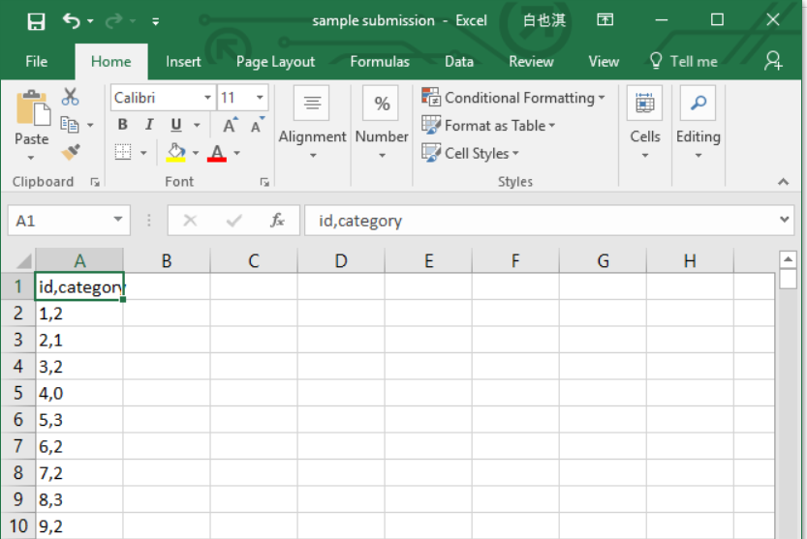
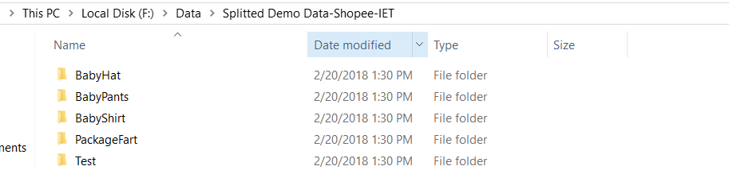
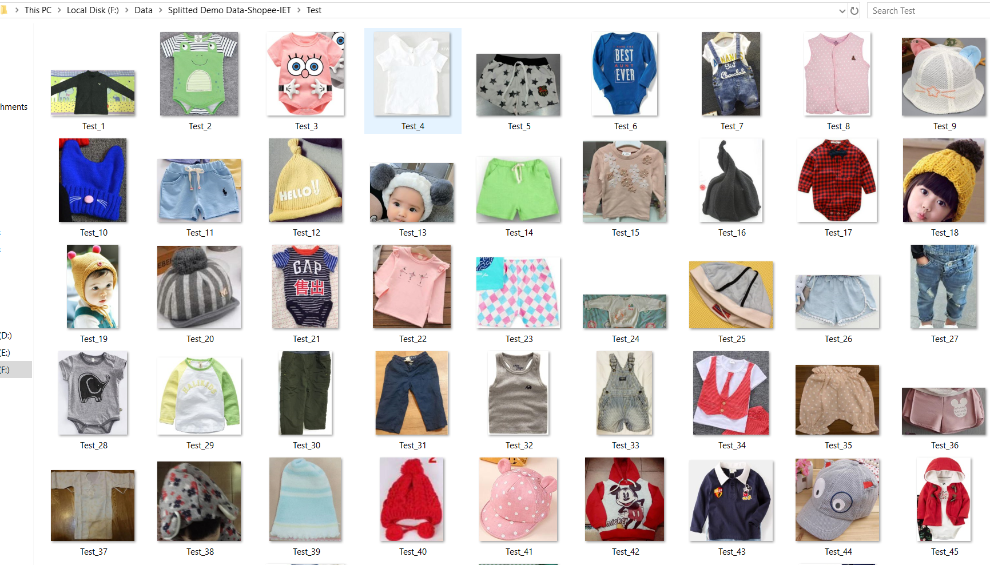
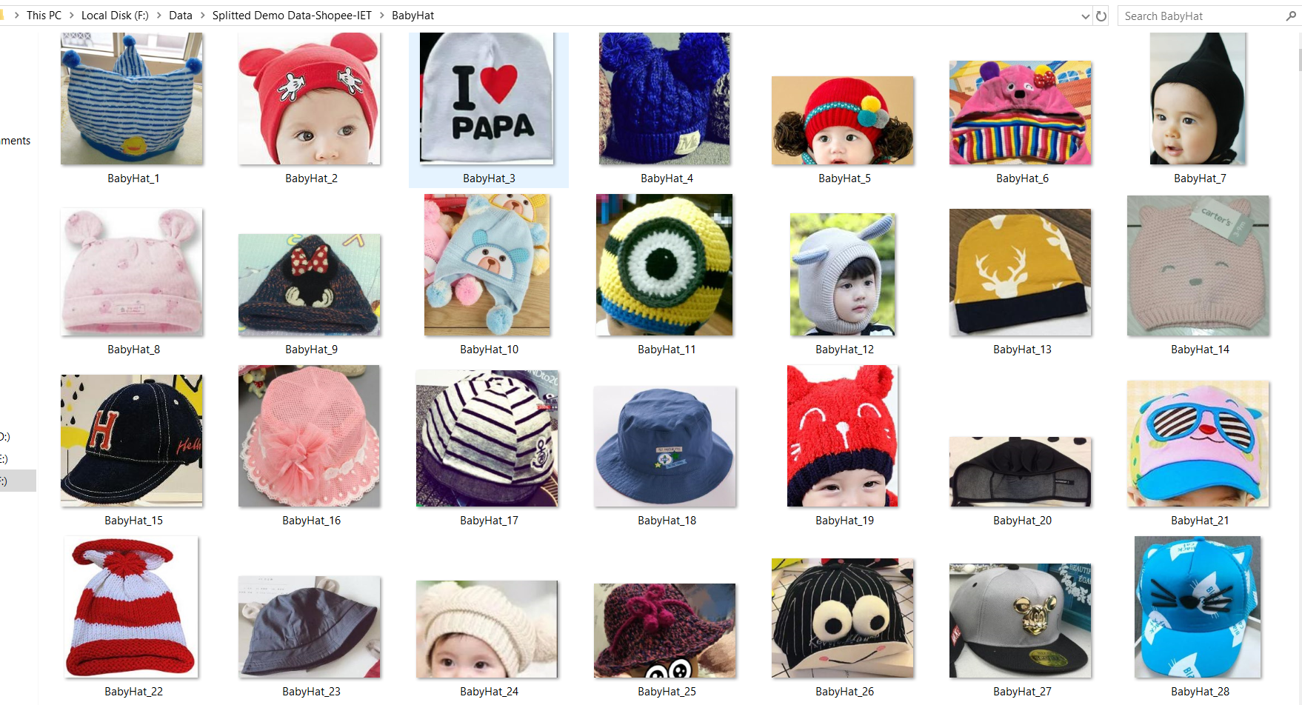
Introduction to the Competition
The aim of the project is to build a model that can predict the classification of the input images. The training/test sets are images provided by Shopee, which are classified into 18 categories.

Slide 4
Rules and Regulations: Shopee-IET Machine Learning Competition
One account per participant
You cannot sign up to Kaggle from multiple accounts and therefore you cannot submit from multiple accounts.
No sharing outside teams
Privately sharing code or data outside of teams is not permitted. However, you need to and should only share code on the forums after the end of the competition.
No hand labeling data
You are not allowed to hand label the test data provided to you. Shopee and IET-NTU on Campus stand the right to test your model built to verify the authenticity of your submission. Shopee and IET-NTU on Campus stand the right to revoke your ranking if hand labelling is detected in any submission of your team.

Slide 5
Team Mergers
Team mergers are not allowed.
Team Limits
The team size is 3-4 participants per team.
Submission Limits
You may submit a maximum of 5 entries per day.
You can only select 1 final submission for judging.
Competition Timeline
Start Date: March 11, 2018
Entry Deadline: March 29, 2018

Slide 6
SHOPEE DATA USE:
You agree that use of, and access to, the Shopee data provided for this Competition is provided for the limited purpose of, and in connection with, your participation in the Competition.
You will not: (a) use or access the Shopee Data for any commercial, gambling, or illegal purpose; (b) copy, modify, reproduce, license, sublicense, distribute, transmit, republish, exhibit, or display the Shopee Data (except to the extent copying, modifying, reproducing or displaying is necessary and directly related to your participation in the Competition); (c) remove, obscure, or modify any copyright notices or other notices, designations, or attributions within the Shopee Data; or (d) use any Shopee Marks or any copyright or other proprietary rights associated with the Shopee Data for any purpose without the express written consent of Shopee “Shopee Marks” means all names, trademarks, logos, symbols, designations, emblems, designs, and trade dress of the Shopee, together with all identifications, labels, insignia or indicia thereof.
DETERMINING WINNERS:
Each Submission will be scored and ranked by the evaluation metric set forth on the Competition Website. During the Competition, the current ranking will be visible on the Competition Website’s leaderboard. The potential winner(s) are determined solely by the leaderboard ranking on the private leaderboard as set forth on the Competition Website, subject to compliance with these Rules.
In the event of a tie, the Submission that was entered first to the Competition will be the winner.

Slide 7
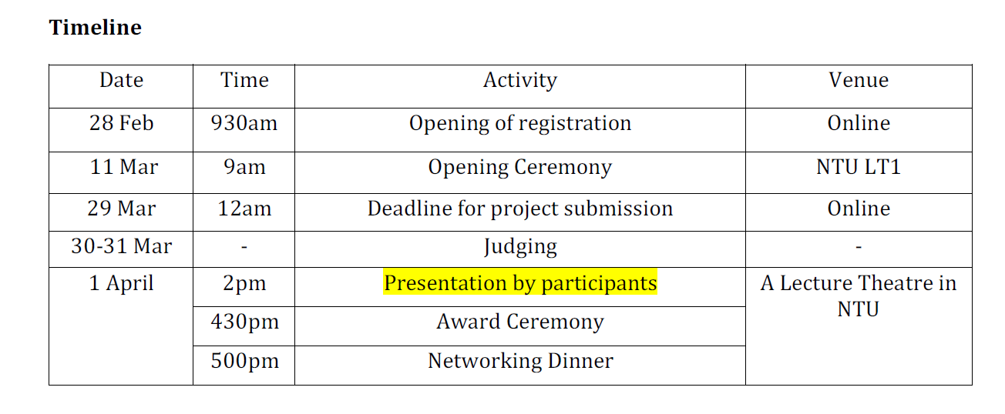
Competition Time Line

Slide 8
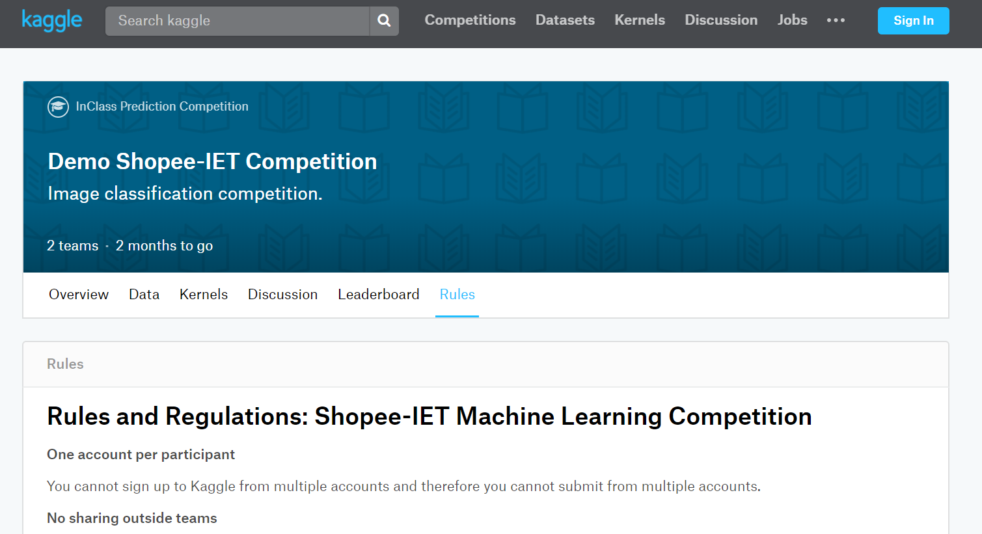
We will be using Kaggle for this competition
Kaggle is a platform for predictive modelling and analytics competitions in which statisticians and data miners compete to produce the best models for predicting and describing the datasets uploaded by companies and users.
Website: https://www.kaggle.com/c/shopee-iet-machine-learning-competition

Slide 9
Introduction to Mentor System

Slide 10

Mentors from Shopee Data Science Team
Yaozhang: yaozhang.pan@shopee.com
Zhaorui: rui.zhao@shopee.com
Ruoxu: ruoxu.ren@shopee.com
Hongxin: hongxin.shao@shopee.com
Mingming Li: mingming.li@shopee.com
Wei Zhang: wei.zhang@shopee.com
Mingxuan Cao: mingxuan.cao@shopee.com
Chester Liew: chester.liew@shopee.com
Deng Yue: yue.deng@shopee.com
Zhihao Sun: zhihao.sun@shopee.com

Slide 11
Mentorship Guidelines
All mentors will have to be there during the briefing session to guide the teams.
To be fair to all teams, all teams are only allowed to interact with their mentors in the 1st week of the project (11 March - 18 March).
Scheduling a meet-up with the mentor is optional and is dependent on the availability of the mentor.
The mentors will only give advice on the direction of the project and provide suggestions in the early stage of the project.
Mentors are not involved in the technical work of the team.

Slide 12

Award
1. COMPETITION TITLE: Shopee-IET Machine Learning Competition
2. COMPETITION SPONSOR: Shopee
3. PRIZES: $2,800
First Prize: $1,500
Second Prize: $800
Third Prize: $500
4. WINNER LICENSE TYPE: Open Source
5. EXTERNAL DATA: Usage of publicly, freely available external data is permitted.
6. Competitions are open only to registered participants from NTU, NUS ,and SUTD.

Slide 13


Why This Competition?
1) Basis of Modern Image Search
2) Learn to Deal with Noises in Real-world Data

Slide 14

Internship & Full-time Opportunity Provided by Shopee Data Science team

Slide 15
Q&A

Slide 16

Accept the Challenge or Not?
Make Your Choice!

Slide 17

Time for Mentor Allocation and Discussion

